Slide 1

Women Rights
Written by:

Slide 2

Table of Content
Introduction……………………………………………………3
Image…………………………………………………………..4
How deep is the problem?.....................................................................5
Waves of women liberation ……………………………………..6
The Yellow Wall Paper……………………………………………7
Original story ……………………………………………………8
Explanation/ Reflection…………………………………………..9
Conclusion…………………………………………………………10
References……………………………………………………….....10
1

Slide 3

Introduction
Women rights are regarded fundamental human rights.
These rights can be categorized as rights to live away from;
A. discrimination
B. Slavery,
C. Violence
And have a right to; be educated vote, own property, earn fair wage equity and equality are practiced.

Slide 4


Graphics

Slide 5

How deep is the problem?
The abused women by rapists, being treated unfairly at work, and domestic chaos have no one to turn to.
The women rights issues have been ignored
Governments are not offering support towards addressing the increasing violence against women (Ross, GutiŽrrez, Gerber & Silliman)
Violence, discrimination, and abuse against the women has continued to be tolerated and systematic

Slide 6

Waves of women liberation
First wave: 19th and 20th century with the main goal being political equality
They were granted the power to vote
Second wave in 1960’s -1980’s whereby the goal was social and cultural equality (Aziz)
The third wave, in 1990’s the continued struggles for the social equality

Slide 7

The Yellow Wall Paper
The story published in 1882. as a secret journal detailing story of a woman recovering from nervous condition
The story highlighted how the husband did not take the condition seriously and recommended her to rest.
She was discouraged from doing anything and being treated as a child (Gilman).
Name calling was also undermine her such as being called little goose, and little girl.

Slide 8
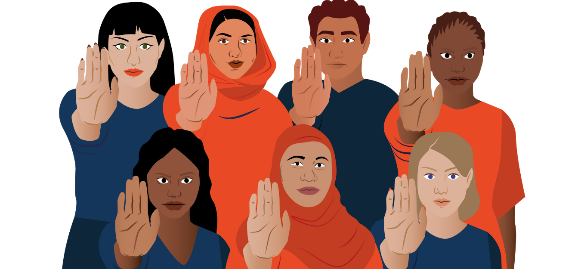
Original story
Rahma, a friend from Somalia is one of victim of systemic women rights violation
Somalia is regarded as having 98% global prevalence of female circumcision (Khosla, Banerjee, Chou et al).
Zero –tolerance policy to these violations and early marriages is a systemic issue that has been difficult to stop
Women rights should never be taken for granted

Slide 9
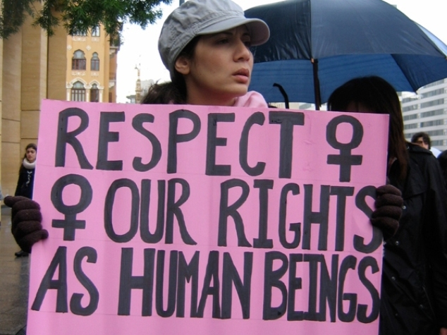
Explanation/ Reflection
The story of Rahma and the Yellow Wallpaper indicated that in this century, despite some mileage, we have a way to go in regards to women rights
My only dream has been to experience equality and equity in all aspects of life.
Nations like Somalia need individuals and the UN, to push for the abolishment of such practices such as FGM and early marriages.

Slide 10

Conclusion
Women rights are fundamental human rights that ought to respected by all
These rights are supposed to be enforced by government and non governmental organizations.
Additionally, it is wrong to treat women as the weaker gender
The deep underlying problems of women rights can be achieved if there is commitment from all angels.

Slide 11
References
Gilman, Charlotte P. The Yellow Wall Paper =: La Carta Da Parati Gialla. Roma: Gruppo editoriale L'Espresso, 2013. Print.
Aziz, Zahid. "Rights of women in Islam." (2016). http://www.ahmadiyya.org/islam/rights-of-women.pdf
Khosla, R., Banerjee, J., Chou, D. et al. Gender equality and human rights approaches to female genital mutilation: a review of international human rights norms and standards. Reprod Health 14, 59 (2017). https://doi.org/10.1186/s12978-017-0322-5
Ross, L., GutiŽrrez, E., Gerber, M., & Silliman, J. (2016). Undivided rights: Women of color organizing for reproductive justice. Haymarket Books.

Slide 12



